Slide 1
Rapid Feasibility Assessment: Modeling the Likelihood of Infrastructure Project Delivery
Analysis using Pipeline Data & Macroeconomic Factors
Sujith Roy S
7 October 2024

Slide 2
Objective & Overview
RFA to to model the likelihood of infrastructure project delivery using the Pipeline information and any other accessible data.
Pipeline dataset contains extensive information on 5940 infrastructure projects, including key details such as, project status, funding status, procurement methods, project descriptions, estimated timelines and location (latitude and longitude).

Slide 3
Assessment
Quality of data was good overall but there were few records for which the Project Start Date was after Project End date. These had to be removed.
The brute force approach was to create a blended weighting system that assigns likelihood based on historical delay specific to project sector, region, funding source, and the duration that a project has spent in a specific phase while factoring in the number of days it has to completion.
However, pipeline data does hold not these crucial information, such as how long a project has been in specific status (e.g., 'On hold', 'In Development') or the reasons behind these statuses.
Including such factors would have made the modeling process much more straightforward.
While its manually possible to extract the data w.r.t how long a project has been in specific statuses , there weren’t enough data points to do it.
So, modelling the ‘likelihood’ directly was out of the picture.

Slide 4
Final Methodology
Total delay is used as a proxy to estimate the likelihood of project delivery.
Approach: Compute total delay for completed projects and use the patterns associated with it for planned/ unfinished projects
Prediction: By modeling total delay using existing and engineered features, we can infer the likelihood of on-time delivery.
Predicted delays are scaled into likelihood percentages for timely delivery, normalized by region and sector.
Higher delays indicate a lower likelihood of on-time project delivery.
Lower delays suggest a higher chance of meeting estimated completion dates

Slide 5
Model Summary
LM1: Predicts ‘total delay’ using features derived from the pipeline data.
LM2: Predicts ‘total delay’ using features from the pipeline data combined with *macroeconomic indicators (CPI, GDP) from Treasury.
**macro data is available till 2028-06 and the same was used for periods beyond that period. No growth rates were assumed.
Model Version | Input Features | Accuracy
LM1 | Average delay in the sector, minimum budget, maximum budget, planned duration, funding status (confirmed or not), project status | ~45%
LM2 | Average delay in the sector, minimum budget, maximum budget, planned duration, funding status (confirmed or not), project status, Project Region, GDP Delta and CPI Delta | ~80%**

Slide 6
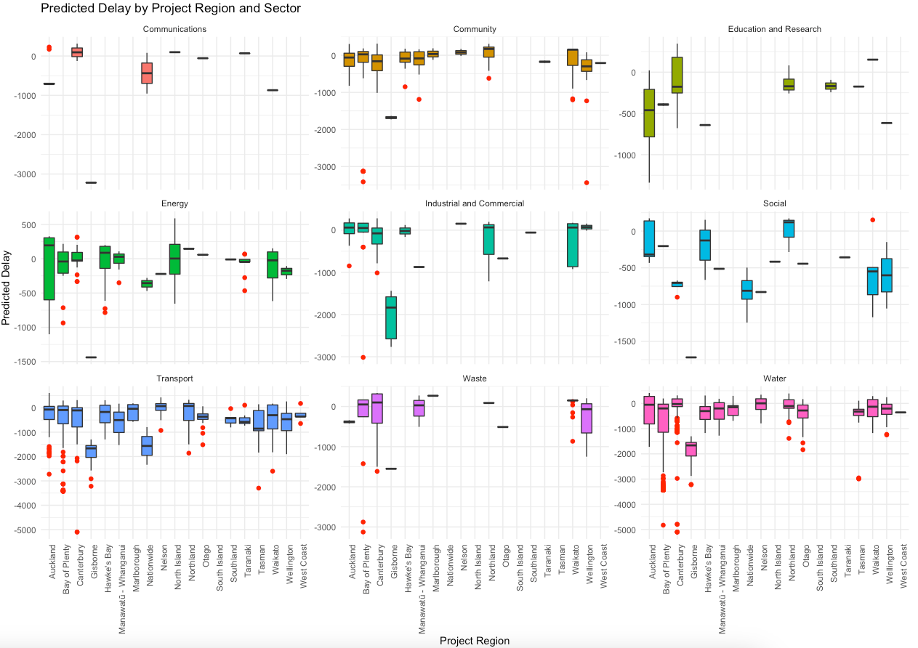
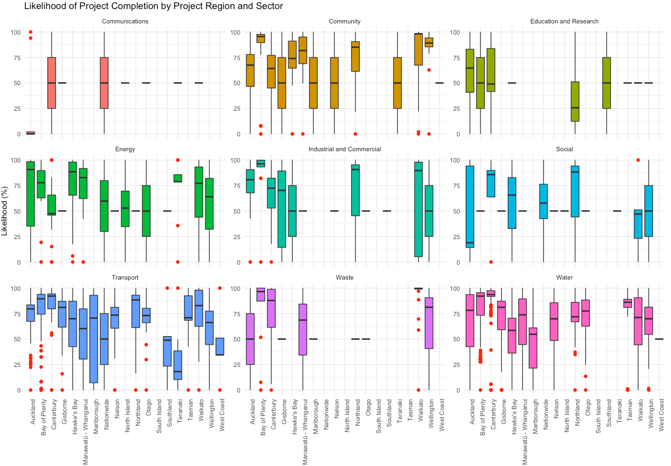
Model Results - LM1

Slide 7
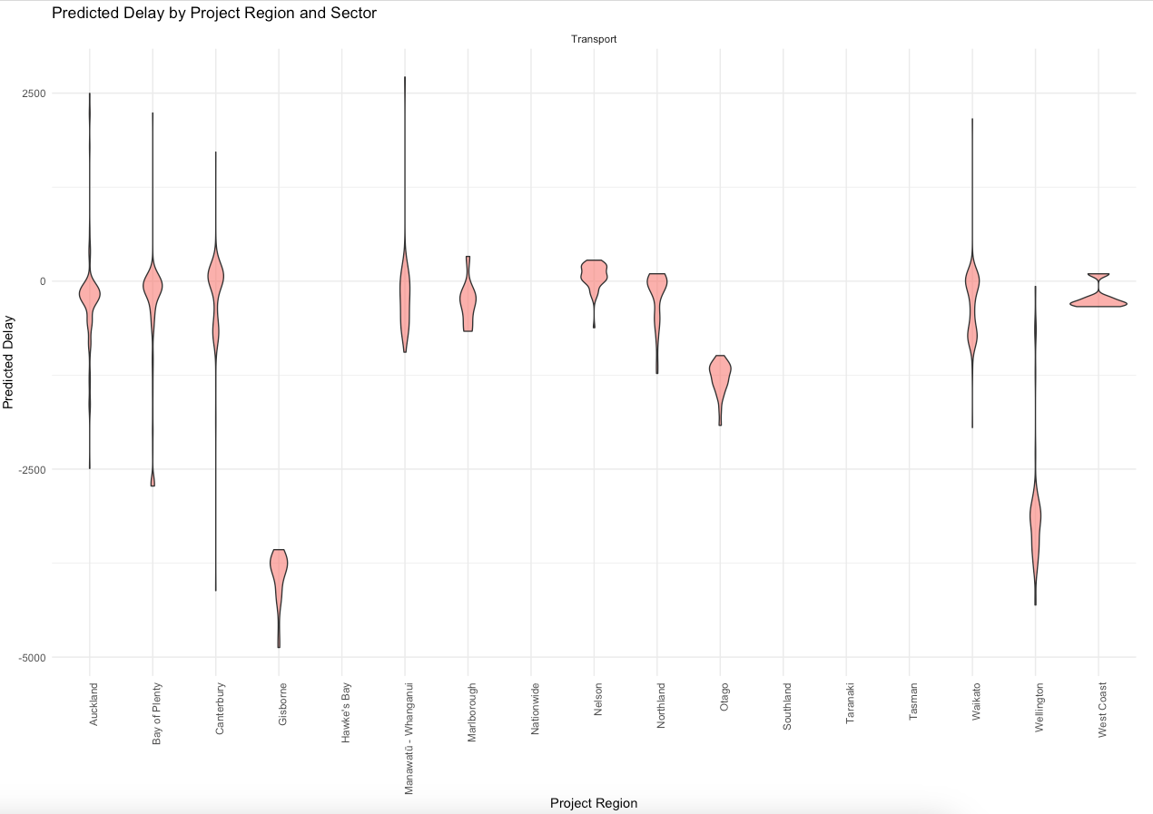
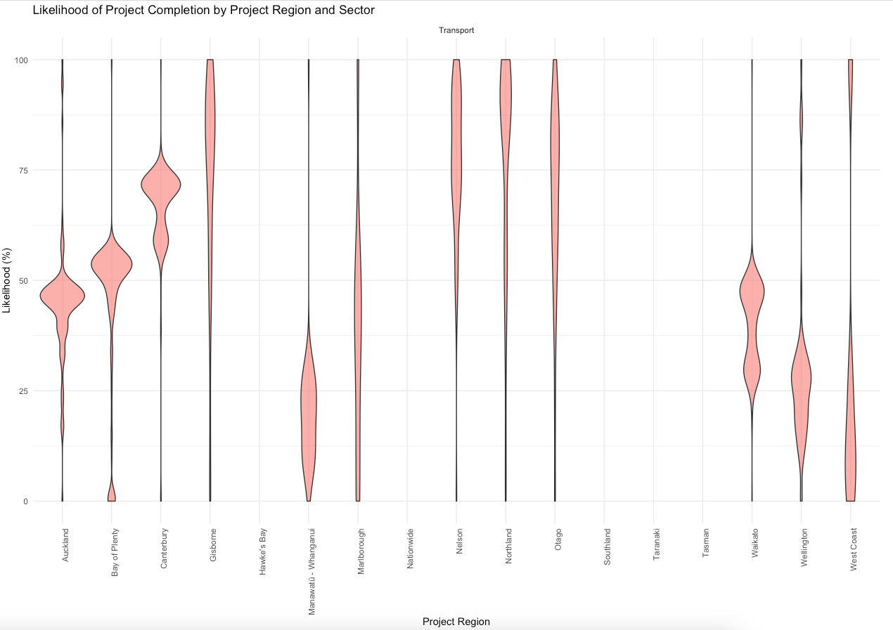
Model Results – LM2

Slide 8
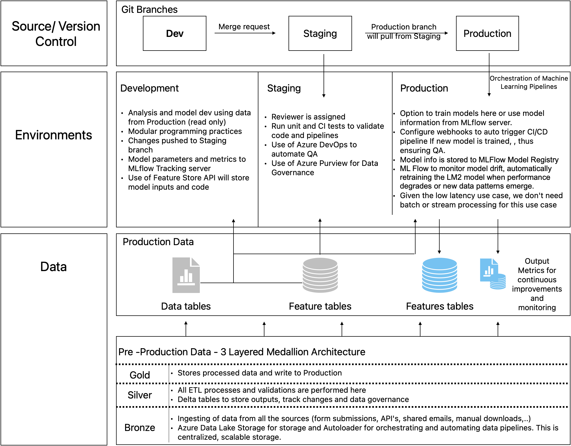
Proposed Architecture

Slide 9
Conclusions
Results of LM2 looks promising in predicting the delivery likelihood of infrastructure project.
Models are only a proof of concept with minimal QA; it needs to tailored for each individual sector.
It can be further optimized by incorporating sector-specific macroeconomic factors, such as using transport-specific CPI instead of general CPI.
Growth rate assumptions for macroeconomic indicators post June 2028 should be factored.
Projects out of the scope of current government naturally have higher uncertainties. This needs to accounted for.
Proposed architecture is easy to scale, and medallion architecture is industry standard.
Use of MLFlow Registry, Tracking Server, Feature Store, Azure DevOps, Purview will enhance the workflow by enabling efficient model management, streamlined deployment processes, and improved data governance, ensuring that data and models are accessible, reproducible, and compliant with industry standards.

